Slide 1
GREAT OUTDOORS
TEAM - A

Slide 2
TEAM A
Madhuri Vemulapaty
Ankush Agrawal
Shreyash Pandey
Sourav Maji
Sarthak Lav

Slide 3
Use Case Diagrams

Slide 4
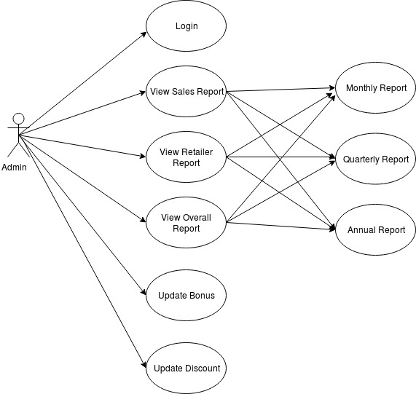
Use Case Diagram - Admin

Slide 5
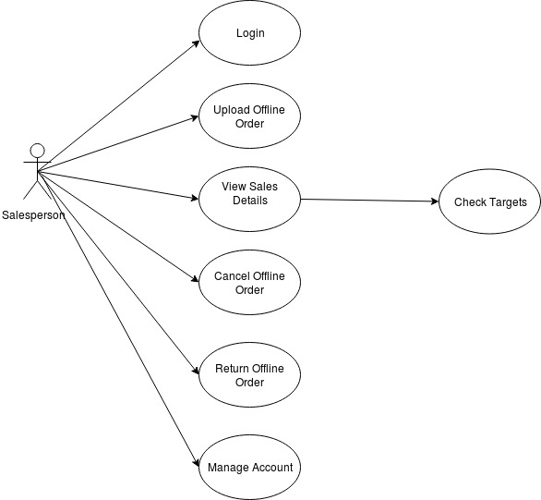
Use Case Diagram – Salesperson

Slide 6
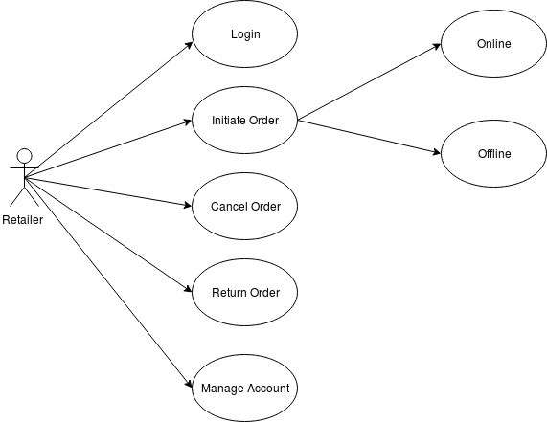
Use Case Diagram - Retailer

Slide 7
ER Diagram

Slide 8
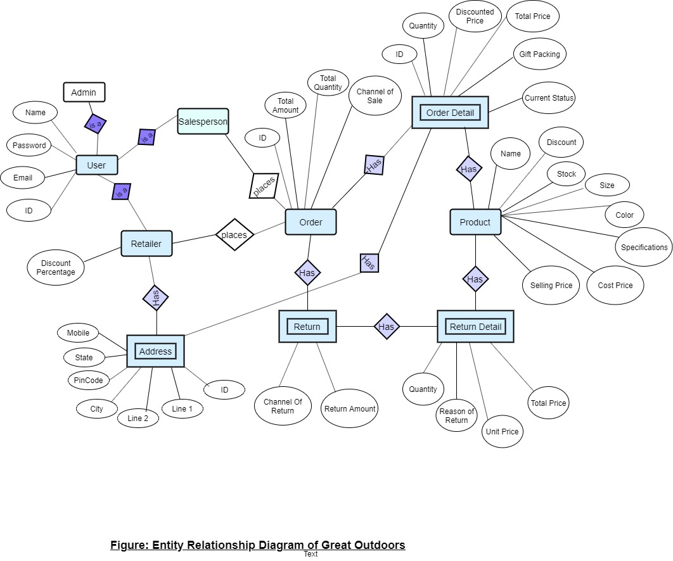

Slide 9
Sequence Diagrams

Slide 10
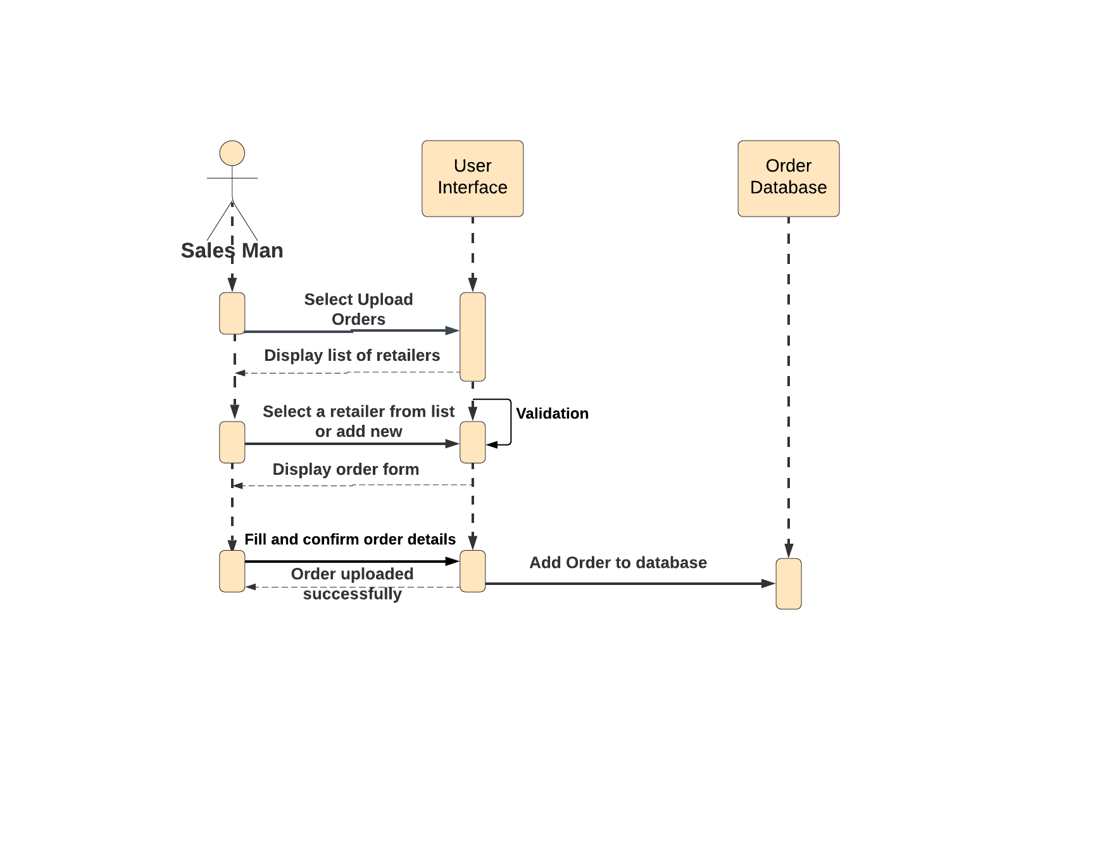
Sequence diagram to upload offline order

Slide 11
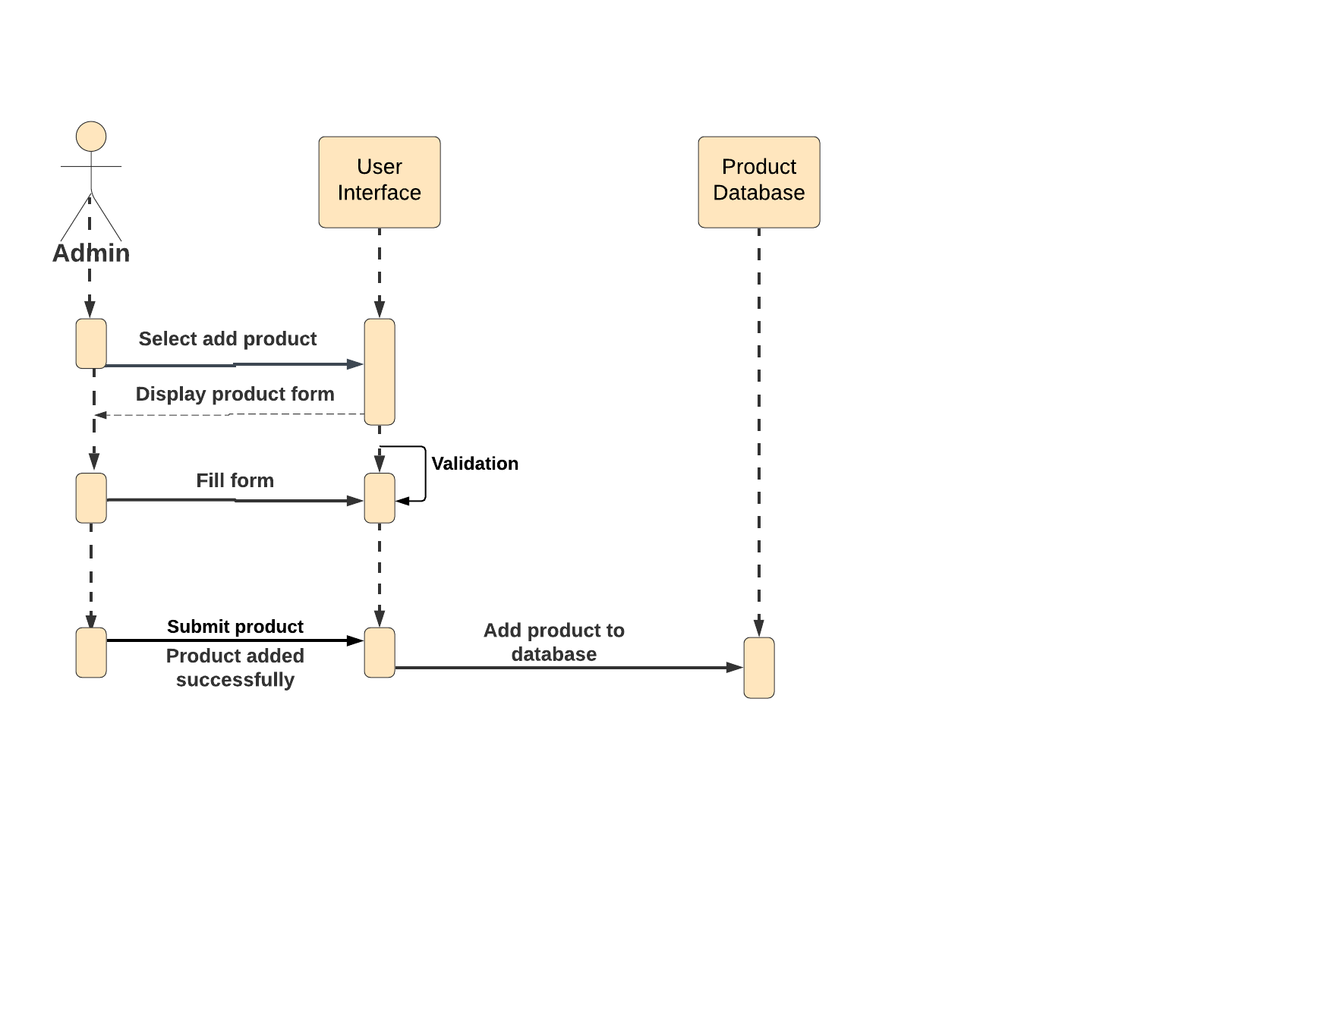
Sequence diagram to add product

Slide 12
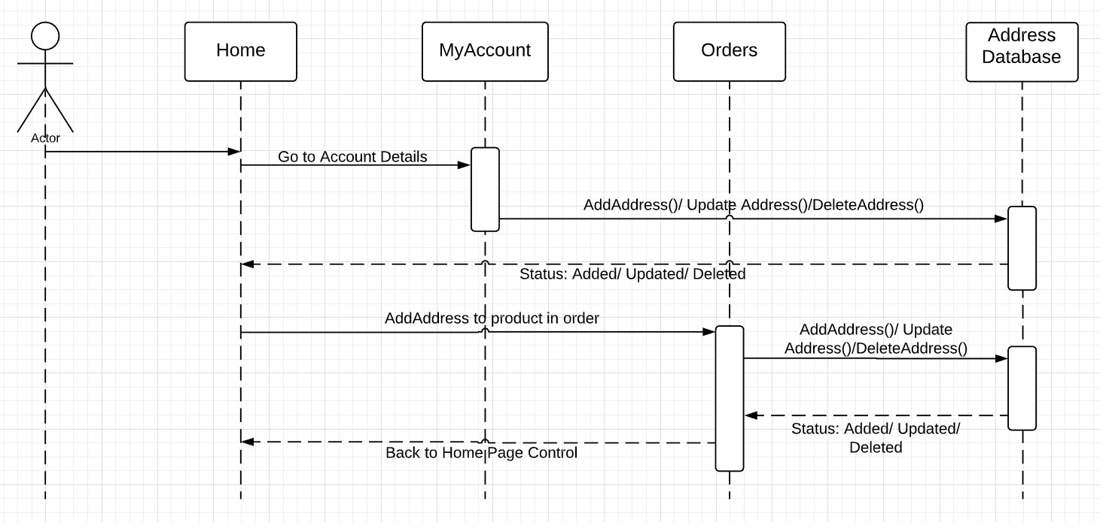
Sequence Diagram to add new address

Slide 13
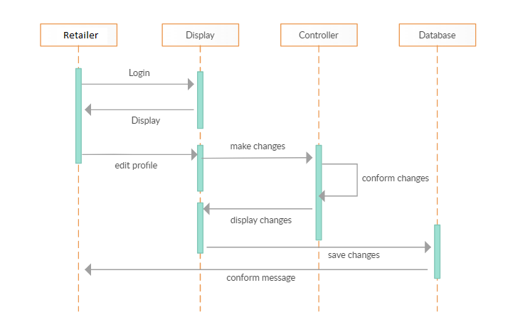
Sequence diagram to update retailer

Slide 14
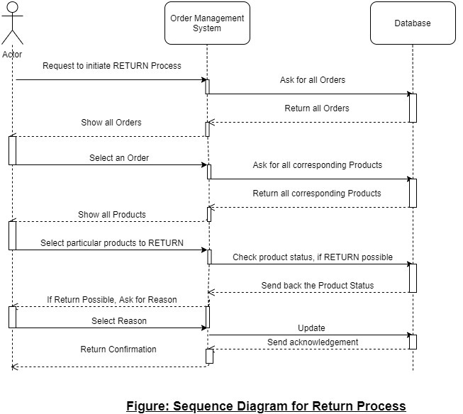
Sequence diagram for return order

Slide 15
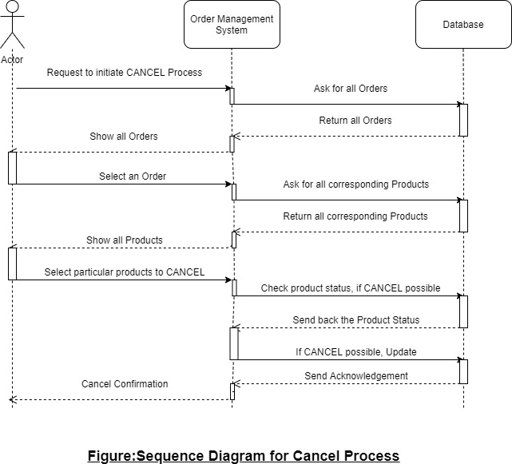
Sequence diagram to cancel order

Slide 16
Activity Diagrams

Slide 17
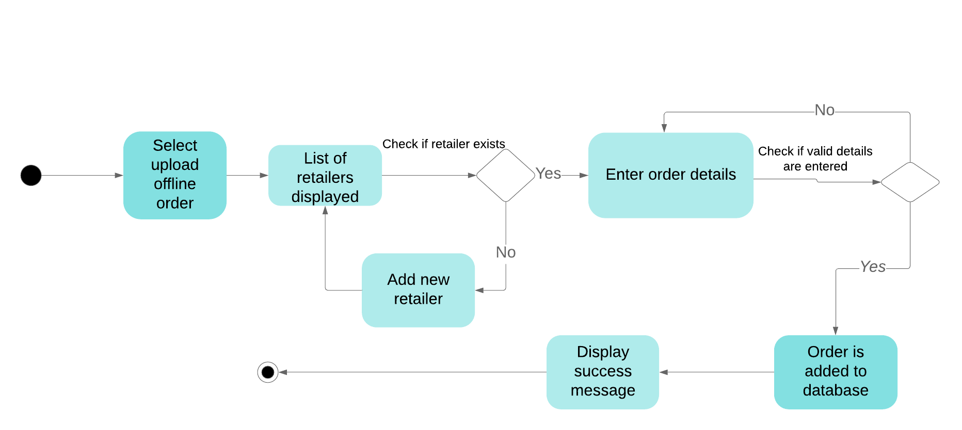
Activity diagram to upload offline order

Slide 18
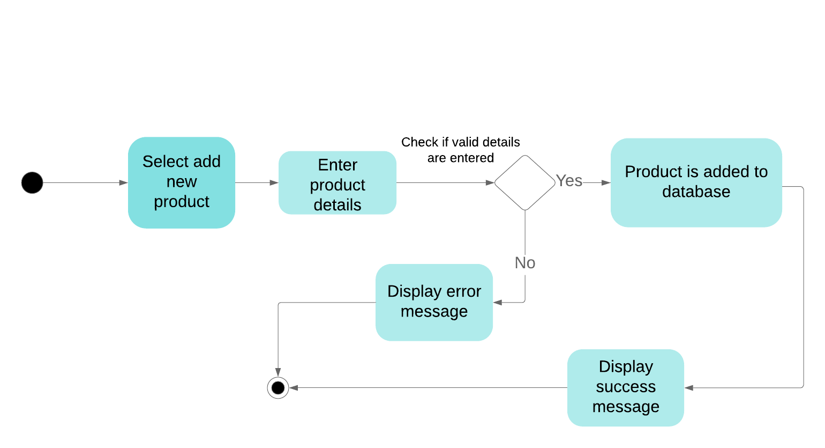
Activity diagram to add product

Slide 19
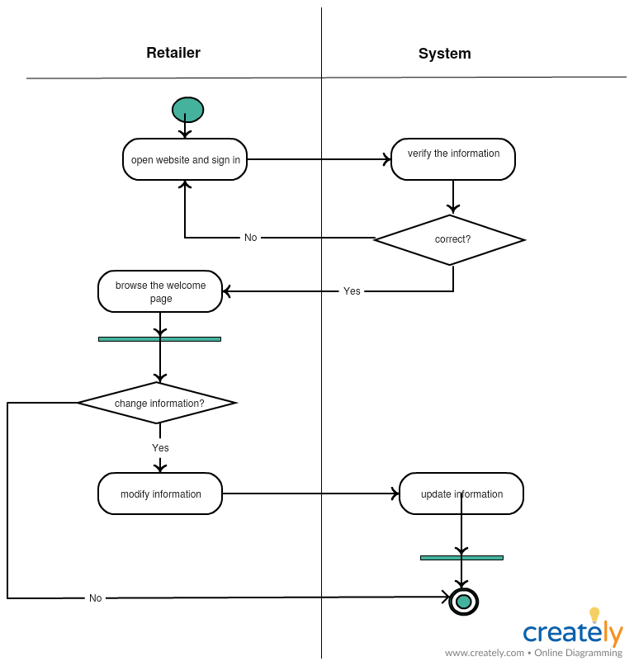
Activity diagram to update retailer

Slide 20
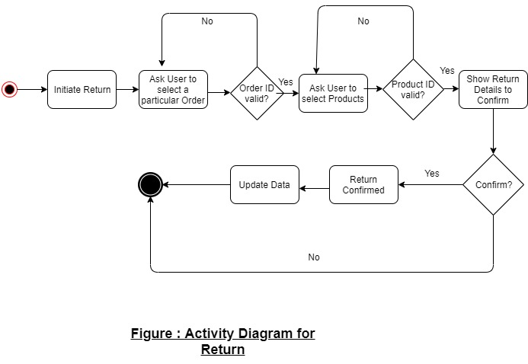
Activity Diagram to Return Order

Slide 21
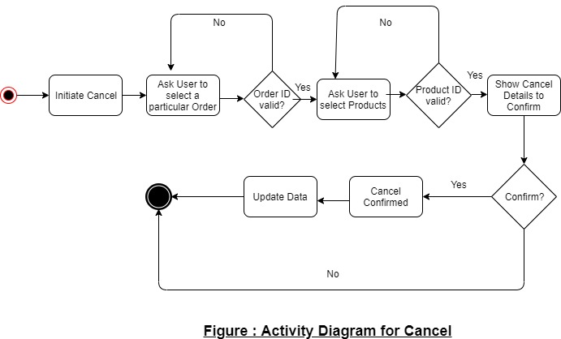
Activity Diagram to Cancel Order

Slide 22
Epic and User Stories

Slide 23
EPIC – Salesman should upload offline orders
User Stories:
Salesman should be able to upload order details like product ID, name and quantity along with discount and total price.
Salesman should be able to view uploaded sales.

Slide 24
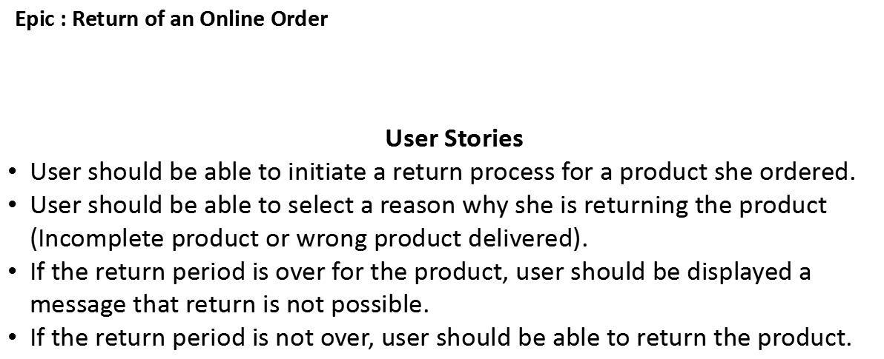

Slide 25
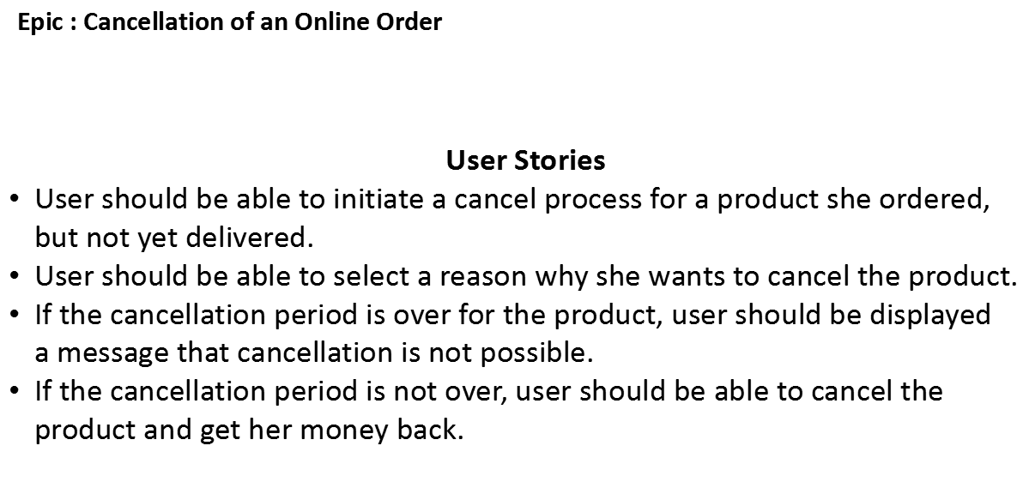

Slide 26
Class Diagrams

Slide 27
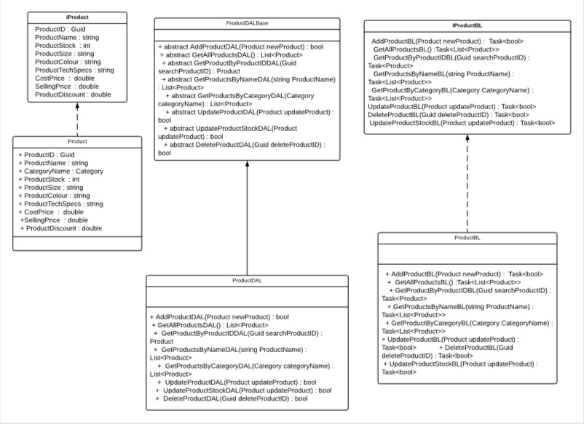

Slide 28
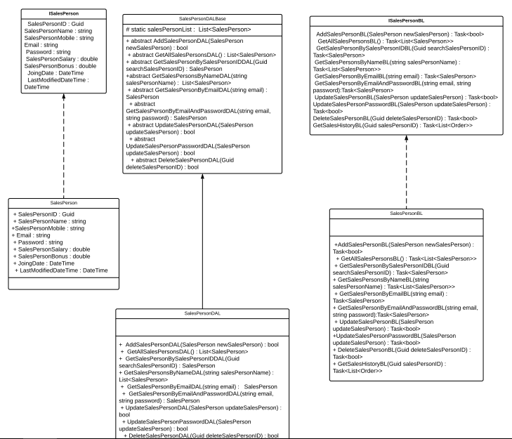

Slide 29
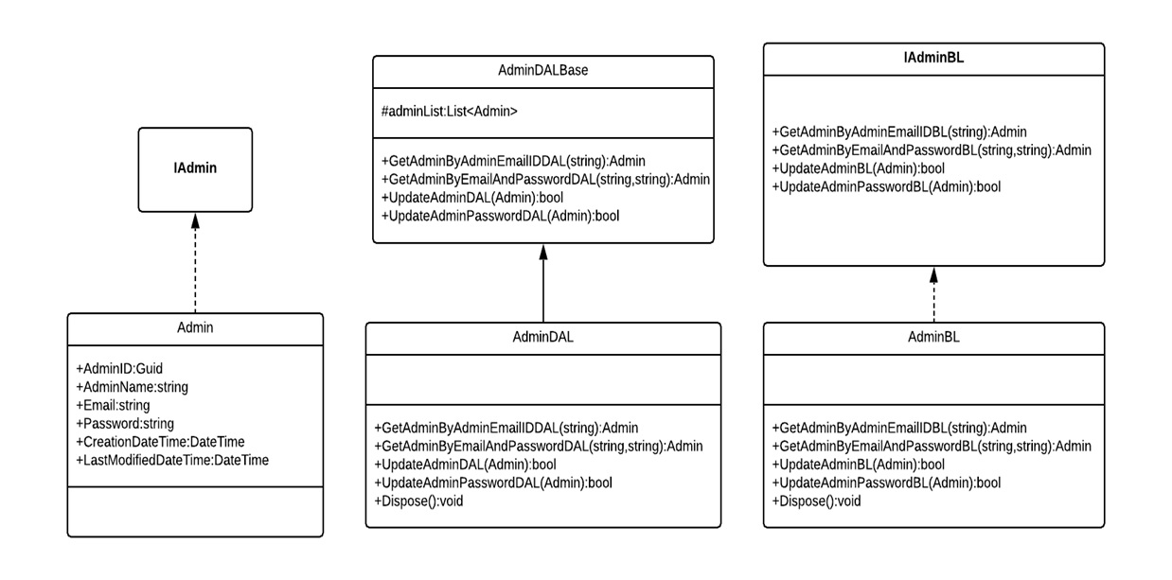

Slide 30
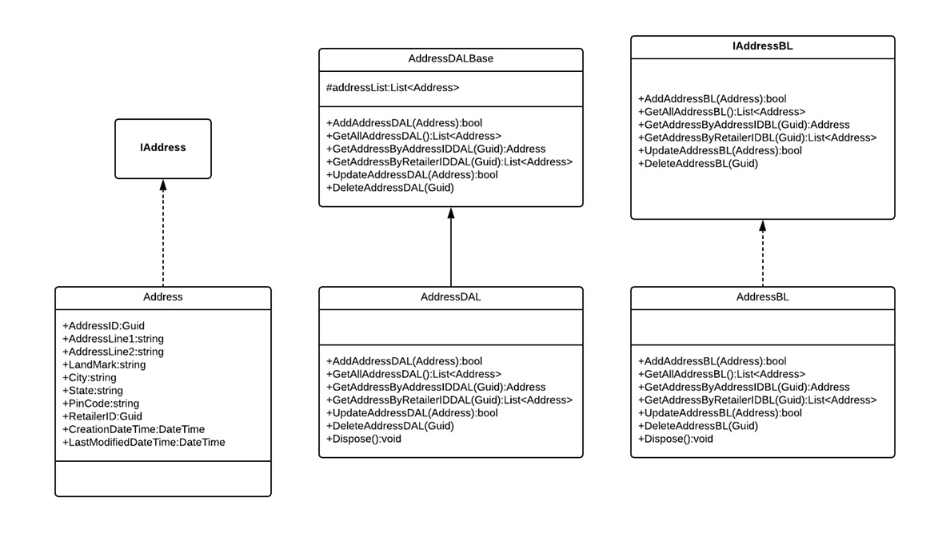

Slide 31
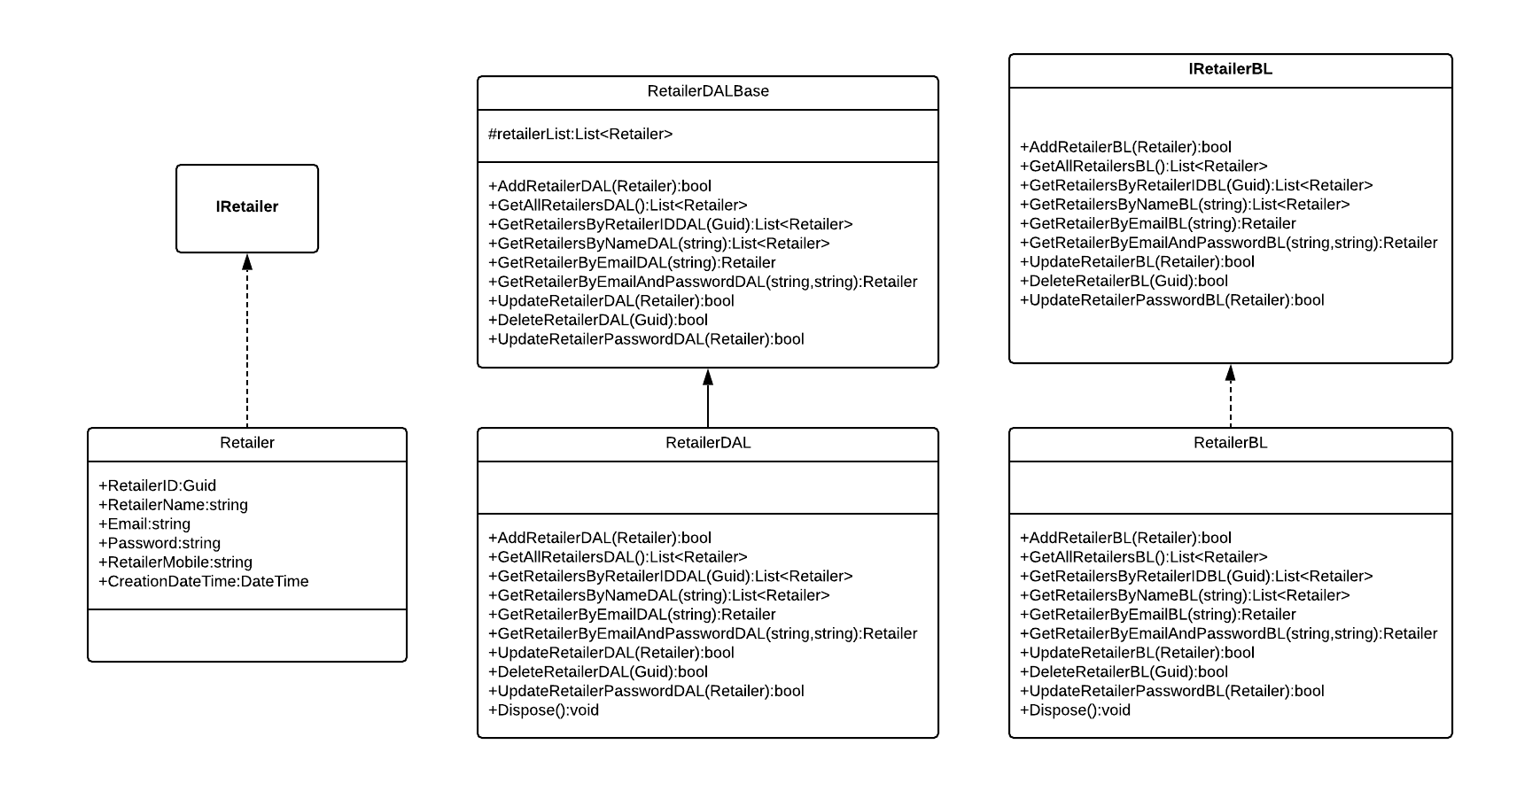

Slide 32
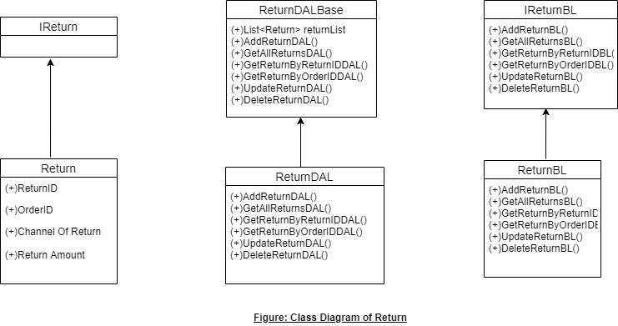
Class Diagram - Return

Slide 33
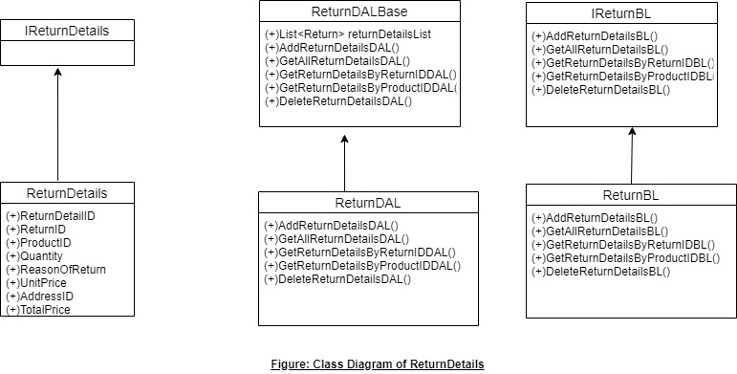
Class Diagram – Return Details

